Slide 1
LIFELINE DIALER
PRESENTED By :
Bhaviyashree M(22AI006)
Pavithra P(22AI033)
Yathigaa T S(22AI058)
Guided By :
Ms. Dr. K. Lalitha
TEAM NO: 5
22AIC14 & INTERNET OF THINGS AND ITS APPLICATIONS

Slide 2
Abstract
Lifeline Dialer is a user-friendly device designed for elderly or disabled individuals.
It features four large buttons, each pre-programmed to dial a specific contact or emergency number.
Utilizing an Node MCU microcontroller and a GSM module, the device ensures easy and immediate communication during emergencies.
It offers a simple interface, reliable call functionality, and is powered by a rechargeable battery, making it an accessible and essential tool for those with limited technical skills.
The Lifeline Dialer is built to support users who may struggle with more complex mobile phone interfaces, offering a straightforward solution for urgent communication needs

Slide 3
Objectives:
Easy Communication: Create a simple device with four large buttons for quick dialing of important contacts.
Pre-Programmed Calls: Set up buttons to call specific numbers: emergency services, a family member, an important person, and a customizable contact.
Reliable Calls: Use a GSM module to ensure clear and consistent voice calls.
User-Friendly Design: Build a durable, easy-to-use device with optional call status indicators.
Portable: Ensure the device is battery-powered for convenience and mobility.

Slide 4
Components Required:
GSM Module (SIM800/SIM900)
ESP Microcontroller (ESP32/ESP8266)
Push Buttons (4)
LCD Display (16x2)
Power Supply (5V DC)
Breadboard or PCB
Jumper Wires
Resistors (as needed for button connections)
Capacitors (for power stability)
Antenna (for GSM module)
11.Supporting Mounts/Connectors

Slide 5
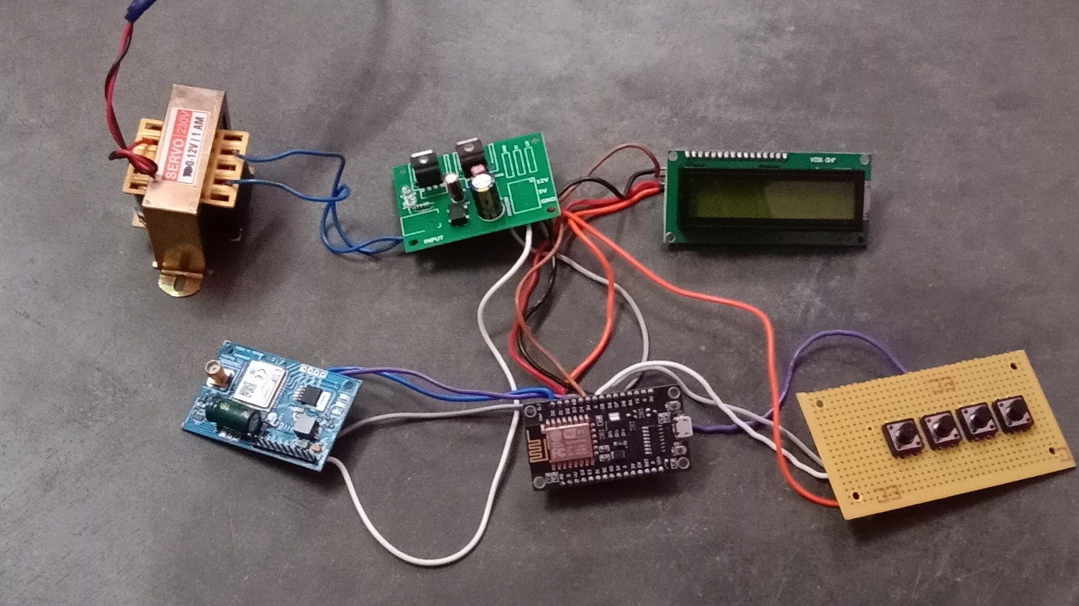
Screenshot

Slide 6
Description
GSM Module: This module is essential because it allows our device to make calls over the mobile network. Once connected, it functions like a basic phone, enabling us to place calls through programmed commands.
ESP Module: We’re using the ESP module as the 'brain' of our system. It manages the inputs from the buttons and sends commands to the GSM module to make calls.
Buttons: We have four buttons on this board, and they serve as the main control points. Buttons 1 and 3 are programmed to call one contact, while buttons 2 and 4 are programmed to call another contact. This way, there’s flexibility if you need to reach different people in various situations.
LCD Display: The LCD display shows important information, like the current status of the call. For example, it can show messages like 'Calling Contact 1' or 'Call Ended,' so the user knows what’s happening.
Power Supply: All these components are powered through a stable power supply. Ensuring consistent power is crucial for reliability, especially in emergencies. We may consider adding a battery backup in the future for extra dependability."

Slide 7
Flowchart
Start
(System Initialization)
Initialize LCD & GSM Module
Waiting for Button press
Check Buttons
(Button1, Button2, Button3)
No
Call Number 1
(From Button 1 or Button 3)
Call Number 2
(From Button 2)
Display 'system Ready'

Slide 8
Implementation: (Hardware or software)
Hardware:
Microcontroller: Node MCU
GSM Module: SIM900
Buttons: 4 Large Push Buttons
Power Supply: 5V Battery Pack or LiPo Battery
Optional: LEDs for status indication
Software:
Arduino IDE: For programming
Libraries: GSM library for call functions
Code: Detects button presses and dials numbers using GSM commands

Slide 9
Usage and Practicality
"This device is incredibly simple to use. Imagine a situation where you need immediate help. Instead of dialing a number, all you have to do is press one button. When you press buttons 1 or 3, the device will automatically call Contact 1. Similarly, pressing buttons 2 or 4 will place a call to Contact 2. This dual-contact setup offers some flexibility, especially if one contact is unavailable or if the user needs different types of assistance.
The display screen adds an extra layer of clarity by showing the call status. For example, it might display 'Calling Contact 1,' 'Busy,' or 'Call Ended.' This setup is especially useful for elderly users, who may find regular phones or smartphones too complex during stressful situations."

Slide 10
Protocol
"For this project, we chose to use the GSM protocol. GSM stands for Global System for Mobile Communications, and it’s a widely used mobile communication protocol. The advantage of GSM is that it allows our device to make regular phone calls, similar to how a mobile phone works.
One of the best aspects of using GSM is that it doesn’t rely on Wi-Fi or the internet. This is important because, in an emergency, users may not have internet access, or there may be a power outage. With GSM, as long as there’s a cellular network available, the Life Line Dialer can make a call, ensuring that help is always within reach."

Slide 11
Future Enhancements
Location Sharing: One enhancement we’d like to add is the ability to send the user’s location along with the call. This could be done through SMS, allowing the contact to know exactly where the caller is, which is especially helpful in emergencies.
Pre-recorded Message: Another improvement would be to add an option to send a pre-recorded voice message. This way, if the contact picks up, they can instantly understand that it’s an emergency and take the appropriate action.
Battery Backup: Right now, our device relies on a stable power supply. In the future, we’d like to integrate a battery backup, so it will continue to work even during power outages. This would make it more dependable in critical situations."

Slide 12
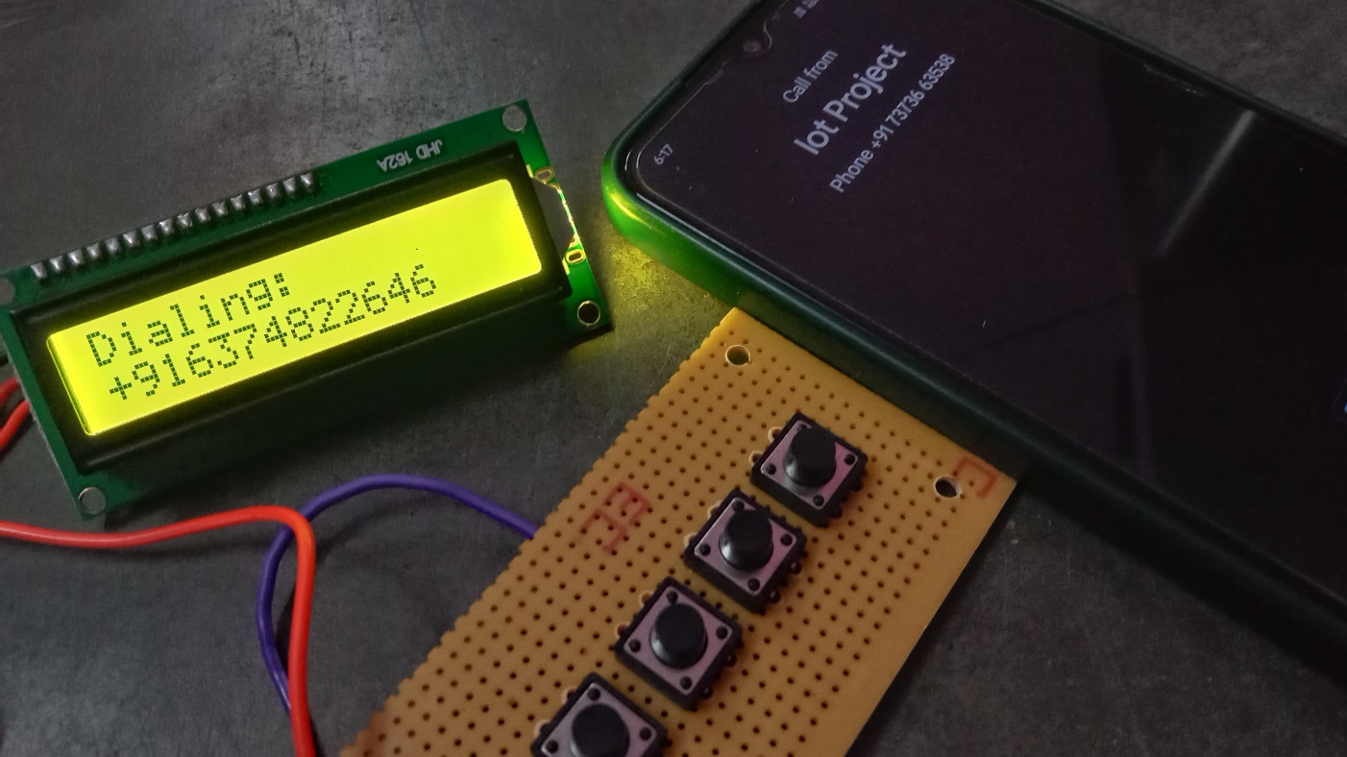
Output

Slide 13
THANK YOU

